Slide 1

Incident management process

Slide 2
Outline
Introduction
Data Preprocessing and Understanding
Relationship b/w variables and target variable
Incidents over time
Feature Selection

Slide 3
Outline
Train Models
Compare Models
Change Hyper Parameters
Give Prediction

Slide 4
Introduction

Slide 5
Introduction
Goal :
The goal is to predict number of days required to close the incident calculated by (closed_at - opened_at)
Input :
incident_event_log_01.csv
Output:
Prediction of days needs to close the incident.

Slide 6
Data Set Information:
This is an event log of an incident management process extracted from data gathered from the audit system of an instance of the ServiceNowTM platform used by an IT company.
The event log is enriched with data loaded from a relational database underlying a corresponding process-aware information system. Information was anonymized for privacy.

Slide 7
Data Set Information:
The attributed closed_at is used to determine the dependent variable in the time completion prediction task.
In this event log, some rows may be having the same values (they are equal) since not all attributes involved in the real-world process are present in the log.
Attributes used to record textual information were not placed in this log.

Slide 8
Dataset Description
UCI Machine Learning Repository
Number of Instances | 141712
No. of attributes | 36
Area | Business
Associated Tasks | Regression
Missing Values | Yes
Attribute Characteristics | Integer

Slide 9
Data Preprocessing and Understanding

Slide 10
Data Preprocessing and Understanding
Convert the feature values in the form to be used for analysis by remove extra information from feature values.
Missing values in the dataset are shown by ? lets convert them in nan which is identifier of missing values in python.
Create a new feature closed_at_opened_at which is used as class variable.
Filter useful information from the dataset to be used further.

Slide 11
Relationship b/w variables
and target variable

Slide 12
Relationship of target and incident number
Insights:
An incident updated to several states before closure.
Like Incidents which are New – Represents if the customer contact the help desk about a new problem, new incident number will be the created by help desk Agent.
Incidents already Exist – Represents if the customer contact the help desk about an existing issue, the Agent of help desk will search existing numbers and update the user status. Therefore, the same incident number is repeated in the dataset with updated values of status.

Slide 13
Relationship of target and incident number
Insights:
Resolution of Incident – When the service has been restored to standard operation, the incident number must be resolved, which may be a fix temporarily or permanent.
Until service has been restored incidents should not be moved to a status of resolved.
Closure of Incident – status of the Incidents must not be moved to a closed until the customer confirmed the incident resolution.

Slide 14
Relationship of target and incident number
Incidents over time
I extract only those rows in which incident_state is New to avoid same dates repeating for a single incident number.
Like incident INC0000045 contain 4 rows in data in which its incident_state feature value change but all other features have same values.

Slide 15
Incidents over time

Slide 16
Incidents over time
At first, let's do some pre-processing to make required columns in format we can use.
I extract only those rows in which incident_state is New to avoid same dates repeated for a single incident number.
Like incident INC0000045 contain 4 rows in dataset in which its incident_state feature value change but its date remain same.

Slide 17
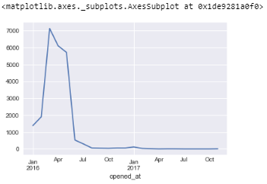
Incidents over time
Monthly
Notice:
As we can observe that maximum incidents are recorded in end of 3rd month of 2016 (2016-03-31) and very few incidents are recorded for months of 2017.

Slide 18
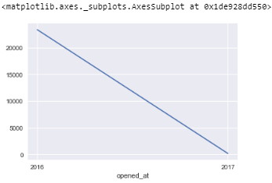
Incidents over time
Yearly
Notice:
As we can observe number of incidents(complains) are reducing yearly which shows company's progress that, it is improving its product quality day by day.

Slide 19
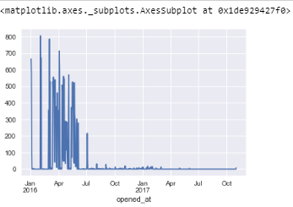
Incidents over time
Daily
Notice:
As we can observe that maximum bookings are done on day 3 of Feb. 2018 (2016-02-03) which are 805.
And very few number of complains are recorded after the July of 2016.

Slide 20
Feature Selection

Slide 21
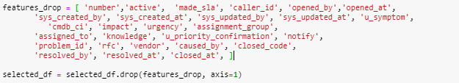
Feature Selection
I drop unnecessary columns/features and keep only the useful ones for prediction task.

Slide 22
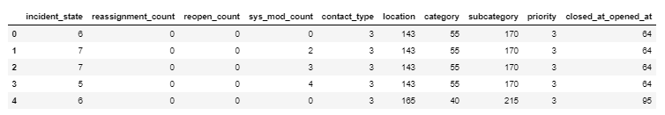
Covert all features into numeric
Data after LabelEncoding

Slide 23
Train Models

Slide 24
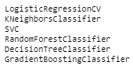
Train Models
Train following models on the dataset.

Slide 25
Compare Models

Slide 26
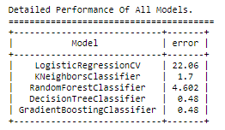
Compare Models Performances

Slide 27
Change Hyper Parameters

Slide 28
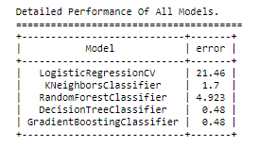
Change Hyper Parameters
By changing Hyper Parameters we are able to improve performances of some models by reducing its error.
As you can see in above comparison last two classifiers have minimum error. I am going to select DecisionTreeClassifier as best model.

Slide 29
Give Prediction

Slide 30
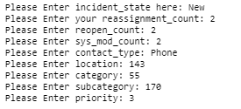

Input from User and give Output
Train DecisionTreeClassifier on all data and take input from user.
Input:
OUTPUT:

